Slide 1

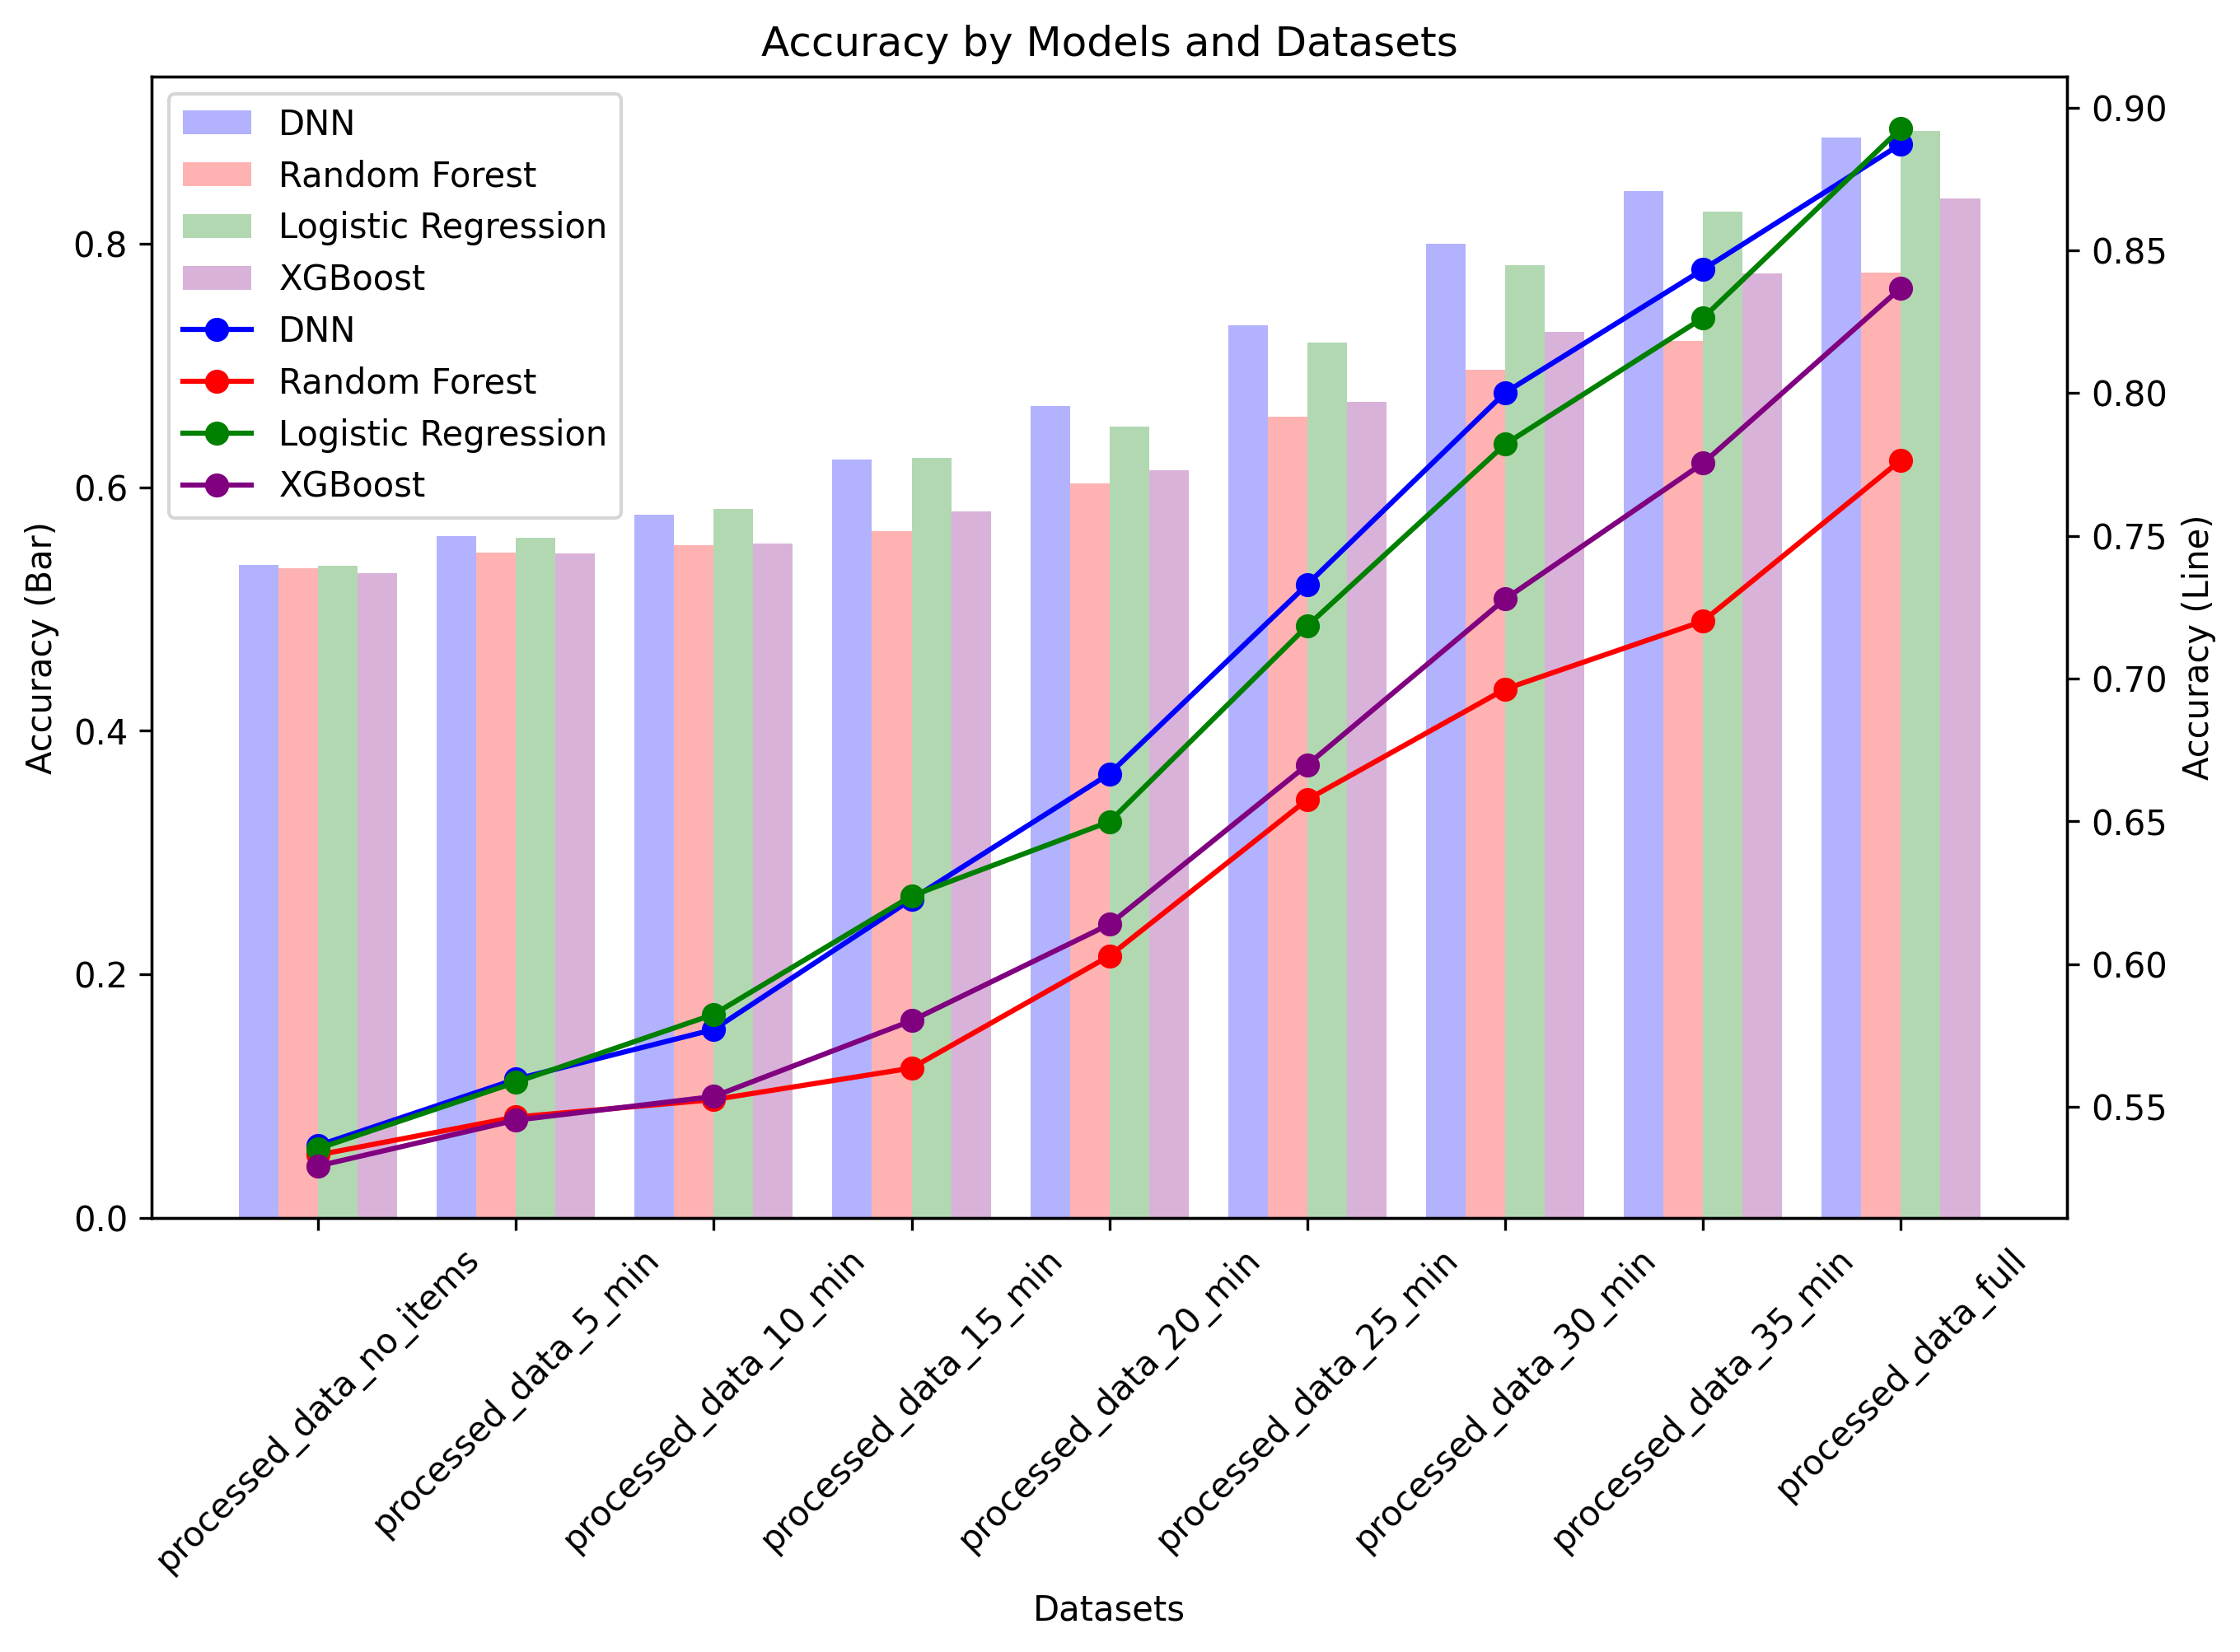
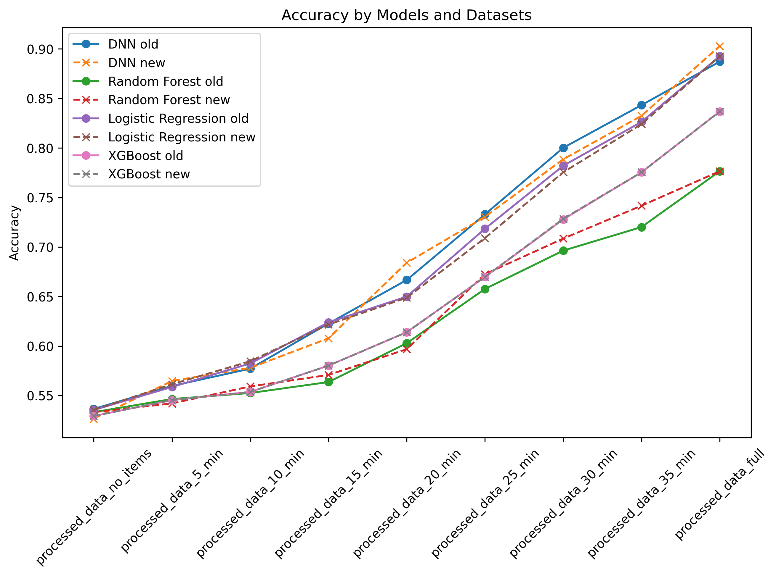
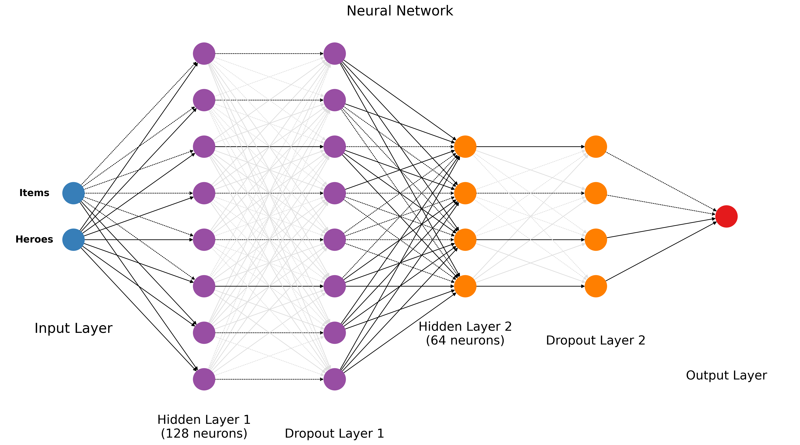
Deep Learning in Digital Gaming: Predicting Outcomes in Dota 2
Ziyuan Cheng (MSc Computer System Engineering) Supervisor: Prof. Martin Lavery
Objectives: This study aims to utilize machine learning models, including Deep Neural Networks (DNNs), Random Forest, Logistic Regression, and XGBoost, to forecast win/loss outcomes in Dota 2. The analysis considers factors such as hero selection, equipment, and time intervals during the game.
Introduction
Dota 2 is a highly competitive online multiplayer game where strategy and decision-making play vital roles in winning.
Traditional analytical methods struggle to capture the intricate dynamics and variables of the game.
Machine learning models, including DNNs, offer a promising approach to understand and predict game outcomes.
The complex relationship between time, equipment, hero selection, and win/loss predictions is a relatively unexplored area.
This study strives to provide insights into the predictive modelling of game outcomes using various machine learning techniques, emphasizing the potential applications not only in gaming but also in broader AI applications.
Result
Early stages (no_items, 5_min): DNN led with an accuracy up to 57.55% and AUC of 0.597.
Mid-game (15_min, 20_min): Accuracy and AUC of DNN increased to 68.16% and 0.751, respectively.
Late stages (25_min, 30_min, 35_min): DNN accuracy reached up to 83.83% and AUC to 0.920.
Full game results: DNN exhibited an exceptional performance with 90.30% accuracy and AUC of 0.968.
Figure 2: Comparative Analysis of Model Accuracy
Figure 3: Accuracy Comparison Following Equipment Weight Amplification
Method
Data Collection: Utilise the OpenDota API to extract 6026 professional game matches between April 19 and June 29, 2023, focusing on parameters such as start time, hero selections, and item timings.
Preprocessing: Isolate relevant features, compute equipment states at predefined intervals, and organise the data into distinct CSV files.
Encoding: Implement one-hot encoding to prepare the CSV files for effective machine learning model training.
Model Training: Independently construct and train Deep Neural Network (DNN), Random Forest, Logistic Regression, and XGBoost models. Document accuracy for comparative analysis.
Weight Adjustment: Increase the significance of equipment information within the CSV files by two-fold, and reassess the models.
Evaluation: Specifically for the DNN model, calculate the Area Under the Curve (AUC) score and design a Receiver Operating Characteristic (ROC) curve for a comprehensive evaluation.
Figure 1: Architecture of the DNN Model
Conclusion
The Deep Neural Network (DNN) model exhibited consistent superiority over other models, with accuracy and AUC improving from 54.23% and 0.557 to 90.30% and 0.968 respectively as the game progressed.
This trend highlights the DNN's adaptability in capturing complex game dynamics. Future research may delve into other deep learning architectures to further this understanding, possibly transcending traditional methods.
University of Glasgow, charity number SC004401

